Slide 1
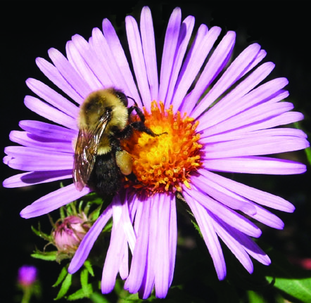
Bees and Pesticides Vera Krischik & Emily Tenczar University of Minnesota
Please use the CUES Pollinator Conservation website for information.
www.entomology.umn.edu/cues/pollinators/
Look at the section on bees and pesticides for more information.
Read the brochure “Pollinator Conservation” to understand the issues and how to mitigate pollinator decline.

Slide 2
Bees and Pesticides Vera Krischik & Emily Tenczar University of Minnesota
How You Can Help
There are a number of things you can do to help conserve pollinators:
Plant trees, shrubs, and flowers that bloom from April through September to create a consistent food supply so pollinators can complete their life cycles.
Minimize the use of broad-spectrum pesticides. These are toxic to bees and include neonicotinoids, pyrethroids, organophosphates, and others. If you must spray, choose a biorational chemical (safer to beneficials) and spray in early evening when most pollinators are less active. Planting insect- and disease-resistant varieties, proper irrigation and nutrition management, and allowing beneficial insects and spiders to visit plants may reduce the need for pesticides.
Provide or preserve nesting sites for native bees. Depending on species, bees may nest in the ground, in cavities, or in wood. Tunnel nests can be constructed with bamboo sticks or wooden blocks. For information on building your own nests for native bees, visit the Xerces Society Pollinator Conservation Program.

Slide 3
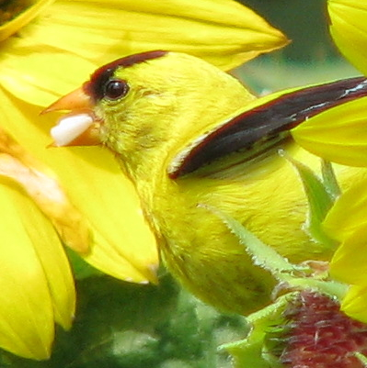
Why Conserve Pollinators?
1. More than 67% of flowering plants need
pollinators (240,000 species).
2. Ecosystem services:
pollination produces fruits and seeds.
3. Fruits fed on by birds, such as crabapple, cherry, chokecherry, mountain ash, apple,
blueberry, sunflower, all need pollinators.
4. 35% of crops, $18.9 billion in U.S.
($217 billion worldwide) require pollinators.
5. 1/3 of the food we eat needs
pollinators.

Slide 4
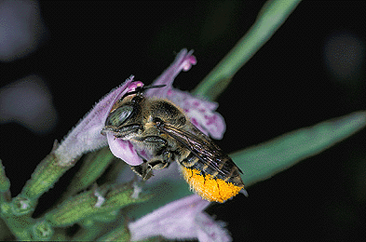
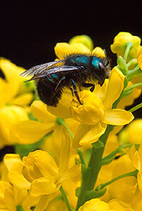
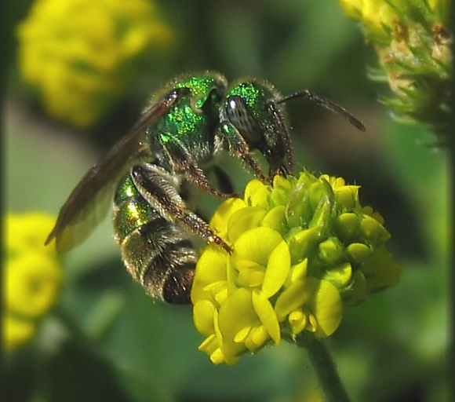
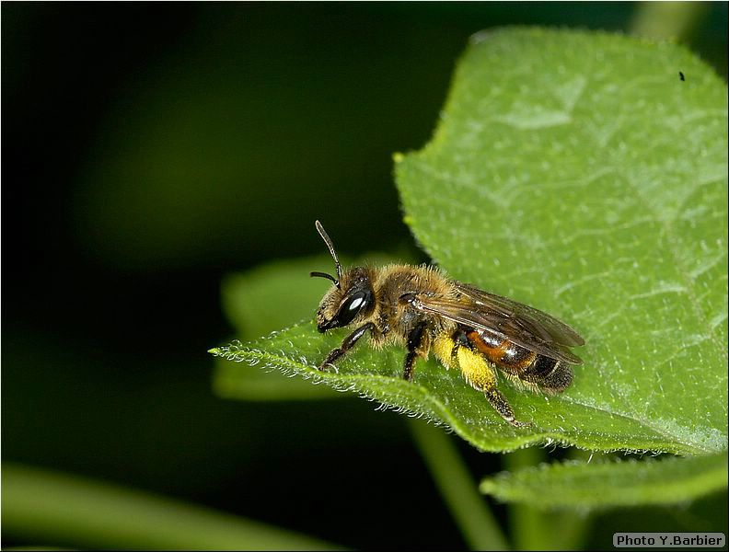
Native Bees also in Decline
Economic value of native pollinators
1. Hundreds of species of native bee contribute significantly to crop pollination.
2. $3 billion/year
Leafcutter bee: Megachile
Sweat bee: Halictidae
Mason bee: Osmia
Bumble bee: Bombus
Digger bee: Andrena

Slide 5
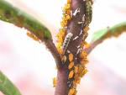
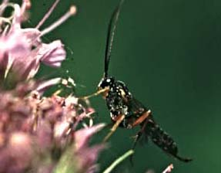
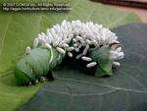
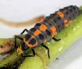
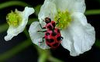
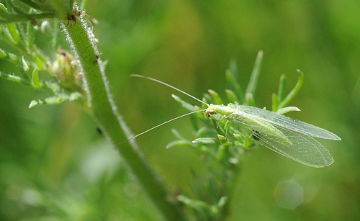
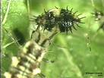
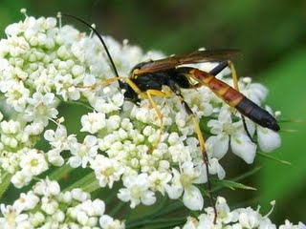
Beneficial Insects:
Flowers provide food for adults. Larvae kill pests.
Adults
Larvae
Adults
Larvae
Notes:
Pictures below show adult insect on left feeding on pollen
and nectar and their larvae on right killing pests.
5

Slide 6
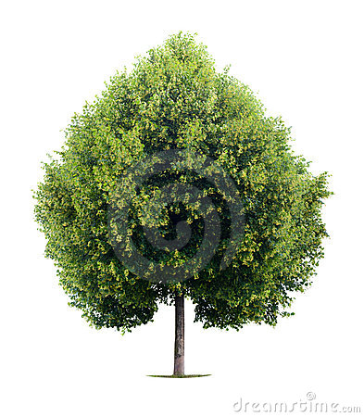
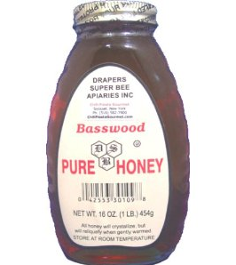
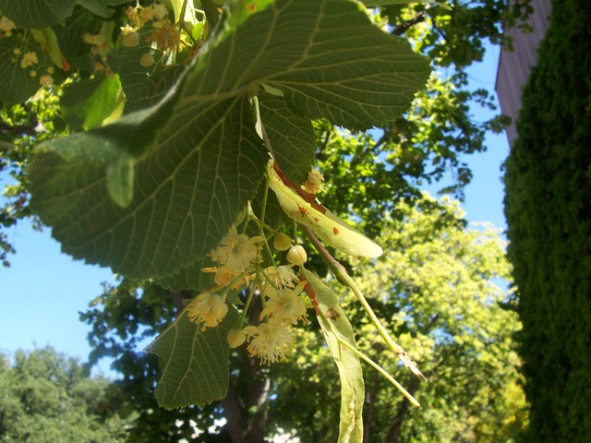
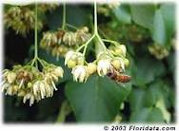
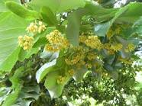
Linden trees: Imidacloprid applied to linden to kill adult JB, but linden is a favorite bee plant

Slide 7
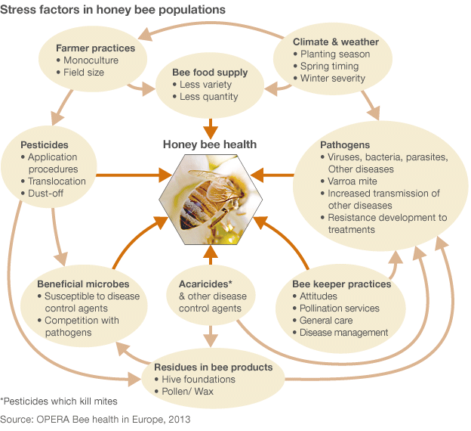
Many stresses contribute to colony collapse
disorder in honeybees

Slide 8
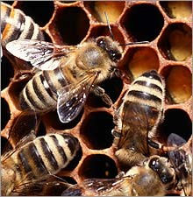
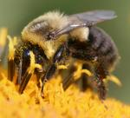
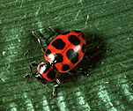
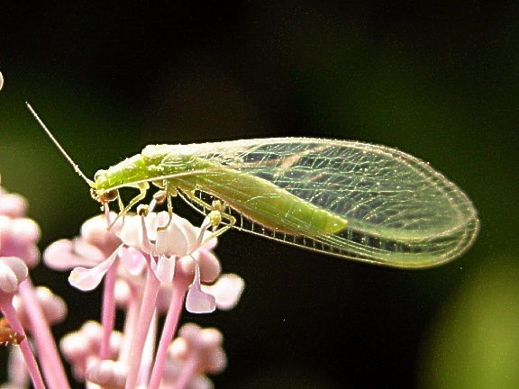
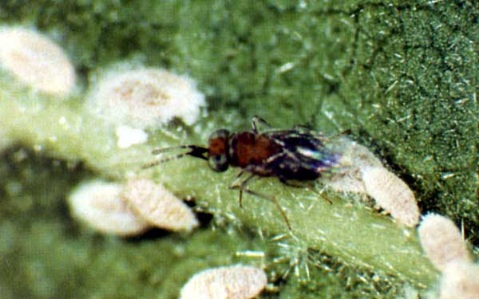
Label rates of imidacloprid result in residues in flowers that kill bees and beneficial insects that feed on pollen and nectar

Slide 9
Insecticide toxicity to humans
Toxicity is defined by the lethal dose or LD₅₀ of a insecticide.
LD₅₀ is expressed as milligrams (mg) of toxican
(insecticide active ingredient) per kilogram (kg) of body weight based on the dose that kills 50 percent of the test animals, normally rodents, under laboratory conditions.
This can be based on either acute or chronic toxicity.

Slide 10
Insecticide toxicity to humans
In addition, LD₅₀ may be determined based on how a insecticide enter the body such as oral (ingestion), dermal (skin), or inhalation (breathing).
This information is then extrapolated to humans.
The lower the LD₅₀ value the more toxic the insecticide is to humans.

Slide 11
On each insecticide product there is a word indicating the relative toxicity of the A.I. to humans. There are 4 categories.
Category I. Contain signal words—Danger/Poison.
In addition, a skull and crossbones symbol is required on labels which are described as high toxic.
These insecticides have an acute oral LD₅₀ range of 0 to 50 mg/kg.

Slide 12
Category II. Contain the signal word—Warning.
Insecticides in this category are described as moderately toxic.
They have an acute oral LD₅₀ range of 50 to 500 mg/kg.

Slide 13
Category III. Contain the signal word—Caution.
These are slightly toxic insecticides.
They have an acute oral LD₅₀ range of 500 to 5000 mg/kg.
Category IV. Contain the signal word—Caution.
These are very low toxicity insecticides that have an acute oral LD₅₀ greater than 5000 mg/kg.

Slide 14
Chemical class/mode of activity
The mode of action is the mechanism that kills the insects.
1. Organophosphates and Carbamates
Inhibit the enzyme cholinesterase. This prevents the termination of nerve impulse transmission.
2. Pyrethroids and Chlorinated Hydrocarbons
Destabilize nerve cell membranes.
3. Neonicotinyls
Work on central nervous system, cause over-stimulation and blockage of the postsynaptic nicotine acetylcholine receptors.
4. Novel insecticides
Mode of action specific.

Slide 15
Most insecticides kill bees by contact
Organophosphates (OP), pyrethroids (P), carbamates (C) are toxic to bees.
Dimethoate (OP) is highly toxic, LD₅₀ 15 ng/bee
Chlorpyrifos (OP) is toxic, LD₅₀ 70 ng/bee
Methyl parathion (OP) is highly toxic, LD₅₀ 11 ng/bee
Coumaphos (OP) is 180 times less than methyl parathion, with LD50 of 2030 ng/ bee
Esfenvalerate (P) is highly toxic, LD₅₀ 15 ng/bee
Cyfluthrin (P) is highly toxic, LD₅₀ 37ng/bee
Beta-cypermethrin (P) is extremely toxic, LD50 2 ng/bee
Lambda cyhalothrin (P) is highly toxic, LD₅₀ 38 ng/bee
Permethrin (P) is extremely toxic, LD₅₀ 8 ng/bee
Carbaryl (C) is extremely toxic, LD₅₀ 1 ng/bee

Slide 16
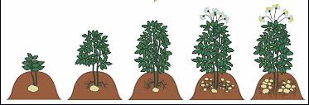
Neonicotinyl insecticides kill bees when they feed on pollen and nectar kill bees by contact. Since 1990, neonicotinoids and pyrethroids replaced organophosphates
Application: Seed treatment (Gaucho), granular or drench treatment into soil (Merit), soil injection (Merit), trunk injection (Ima-Jet).
Systemic, from roots throughout plant to nectar and pollen (Merit, Admire, Marathon).
Moves less thru a plant when applied to leaves (Provado).

Slide 17
There are 6 common neonicotinoid insecticides that are all systemic. When applied to the soil or sprayed on the leaves the insecticides are translocated from roots throughout the plant. The Ai is the active ingredient and the trade name is the name for the product given by the manufacturer. The trade name of consumer insecticides are long. See the CUES brochure on pollinator conservation.
Active Ingredient | Trade Name
acetamiprid | Tristar, Assail
clothianidin | Poncho (GMO seed treatment), Arena, Celero
dinotefuran | Scorpion, Safari
imidacloprid | Gaucho (GMO seed treatment), Marathon, Merit, Admire
thiacloprid | Calypso
thiamethoxam | Actara, Adage, Cruiser (GMO seed treatment), Flagship, Meridian
Notes:
Mimics acetocoline transmitters bind and stay on receptors more readily causing a continuous firing of nicotinic receptors

Slide 18
Systemic insecticides
Organophosphates
aldicarb (Temik), oxamyl (Vydate), dimethoate (Cygon)
Neonicotinoids
imidacloprid (Marathon, Merit), clothianidin, thiamethoxam,
dinotefuran
Novel mode of action
pymetrozine (Endeavor)
Translaminar, or local, systemic activity
Microbial- abamectin (Avid)
IGR- pyriproxyfen (Distance)
PR- chlorfenapyr (Pylon)
SP- spinosad (Conserve)
OP- acephate (Orthene)
C- carbofuran (Furadan)

Slide 19
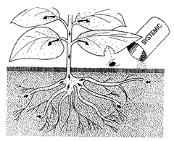
Neonicotinoids: Trade offs
Advantages:
Neonicotinoids most often applied to the soil and are translocated through the entire plant.
Variety of application methods: soil drench, irrigation, seed treatment, tree injection.
Safer to mammals, birds (selective-binding to insects).
Disadvantages:
Neonicotinoids most often applied to the soil and are translocated to pollen and nectar.
Harmful against beneficial insects eating pollen, nectar
Long lasting residual effects (pollen, nectar, leaves, soil).
Bayer argues 20 ppb imidacloprid will not affect mortality, but will affect behavior.
Notes:
Neonicotinoids replacing Organophosphates and Pyrethroids
Can be applied via soil drench granularly foliar spray direct injection or seed coating... This variety of methods helps limit no target effects
Imidacloprid started to become used in US in 1994

Slide 20
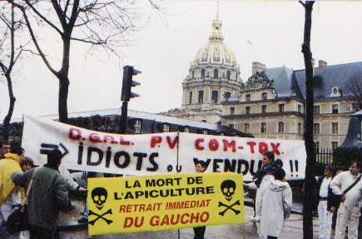
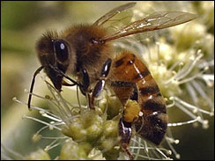
Since 1990 the seed treatment Gaucho for corn and canola was banned in France
Notes:
20
20

Slide 21
See recent research Marzaro 2011, Krupke 2012, Tapparo 2012 at the CUES website under pollinator conservation, then bees and pesticides
2013 May ban in European Union for 2 years starting
2008 seed treatments suspended Germany; others bans in France, Italy, Spain, Slovenia
Suspended are: Antarc (imidacloprid), Chinook (imidacloprid), Cruiser (thiamethoxam), Elado (clothianidin), Faibel (imidacloprid), Poncho (clothianidin).
2010 April/May at Purdue, Indiana, insecticide dust from planting corn killed bees.
Notes:
21
21

Slide 22
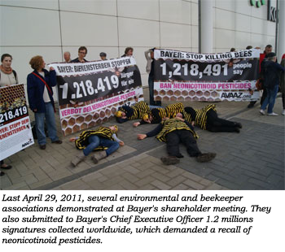
Beekeepers
Petition for clothianidin to be withdrawn from sale
Registration was based on a Bayer study that was later found by beekeepers to be deficient; later EPA agreed (Feldman et al. 2010).
Insecticide seed coating dust extremely toxic to bees, new studies with clear evidence (Krupke et al. 2012, Tapparo et al. 2012, Marzaro et al. 2011).
Insecticide use contributes to weakened immune system increased susceptibility to pathogens (Alaux 2010, Hawthorne & Dively 2011, Pettis et al. 2012).
lovethehoneybees.blogspot.com
Notes:
Study based off
April 29 2011 environmental and beekeeper associations went to Bayer’s shareholder meeting to demand a recall of neonicotinoid insecticides.

Slide 23
Neonicotinoid: Use in Minnesota 2009
Commodity | Imidacloprid AI | Clothianidin AI
Crop chemicals | 46,766 | 19,347
Turf / ornamental | 3,095 | 95
Garden and lawn | 1,636 | 12
Structural | 1,591 | 0
Animal care | 63 | 0
Industrial, forestry | 13 | 0
Home | 9 | 0
Total use | 53,173 lbs | 19,454 lbs
Minnesota Department of Agriculture
Notes:
round

Slide 24
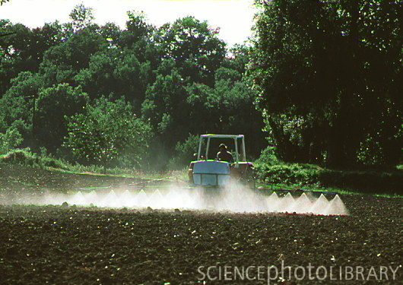
Neonicotinoids: Persistence in the environment
Active ingredient | Soil half-life (days) | Reference
clothianidin | 148 - 1,155 | EPA (2003)
imidacloprid | 40 - 997 | NPIC (2010)

Slide 25
Water solubility: Neonicotinyl insecticides
 | imidacloprid | clothianidin | dinotefuran | thiameth-oxam | emamectin benzoate
Trade name | Merit Marathon | Arena | Safari | Flagship Meridian | Tree age
KOC | 132-310 | 160 | 23 | 64 | 283,000
Solubility (mg/l) | 514 | 259 | 259 | 327 | 101
LD50 (acute rat oral) (mg/kg) | >5,000 | 4,870 | >2,000 | 5,523 | 1,516
dinotefuran is 80 times more water soluble than imidacloprid
emamectin benzoate has very low mobility (KOC) and long duration

Slide 26
Case study: neonicotinoid consequences on bees
Commonly used neonics are very toxic to bees.
Thiamethoxam (seed treatment) oral, highly toxic 30 ng/bee
Clothianidin (metabolite thiamethoxam) (seed treatment) oral, highly toxic 22 ng/bee
Imidacloprid (granular, seed treatment) oral, highly toxic ng/bee 18 ng/bee
Dinotefuran (granular) oral, highly toxic ng/bee 75 ng/bee

Slide 27
Case study: neonicotinoid consequences on bees
Not as toxic to bees.
Acetamiprid contact, moderately toxic 7.1 microg/bee
Thiacloprid oral, slightly toxic 14.6 microg/bee

Slide 28
Imidacloprid residue in nectar
Marathon applied to containers in the greenhouse results in higher concentrations of imidacloprid in nectar compared to Gaucho: 15 ppb vs. 1.9 ppb (Schmuck et al. 2001).
Beneficial insects in the foraging environment may be exposed to imidacloprid in nectar from a range of sources.
Other systemic neonicotinyls, such as acetamiprid, dinotefuran, clothianidin and thiamethoxam are also being used, and may kill beneficials.
Notes:
28

Slide 29
Imidacloprid residue in nectar
Gaucho seed treatments: Imidacloprid in nectar
1.9 ppb in sunflower nectar (Schmuck et al. 2001).
0.6-.8 ppb in canola nectar (Scott-Dupree & Spivak 2001).
Imidacloprid soil treatments: Imidacloprid in nectar
3-10 ppb in purple tansy nectar (Wallner et al. 1999).
15 ppb (1X) and 27 ppb (2X) buckwheat nectar (Krischik et al. 2007).
26 ppb (27d), 12 ppb (38d), 9 ppb (63d), reapplied 53 ppb (21d) in tropical milkweed.
Notes:
29
29

Slide 30
Neonicotinoids: imidacloprid residue levels
Plant | ppb | sampling | Reference
Sunflower (seed treatment) | 2 nectar 4 pollen | At bloom | Schmuck et al. 2001
Pumpkin (soil drench, irrigation) | 4 - 12 nectar 37 - 87 pollen | At bloom | Dively & Hooks 2010
Buckwheat (soil drench) | 15- 27 nectar | 21 days | Krischik 2007
Horse chestnut tree (trunk injection) | 5-283 blossom | 7 days | Maus et al. 2004b
Cornelian cherry Serviceberry (soil drench) | 1,038- 2,816 66-4,560 blossom | 540 days | Doering et al. 2005a,b

Slide 31
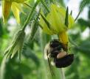
Site | Imidacloprid Treatment Rate
Seed treatment Gaucho* | 0.11 mg AI imidacloprid/1 plant FRENCH RESEARCH
Field crops | 4 mg/sq ft NOT RESEARCHED
Greenhouse/ nursery pot | 300 mg AI/pot KRISCHIK
Landscape, rose | 630 mAI/plant NOT RESEARCHED
15 in DBH 24 in DBH | 50 g AI 76 g AI NOT RESEARCHED

Slide 32
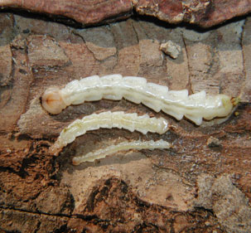
Landscape Management of EAB:
Non-target consequences on bees, good bugs, and birds
1. Imidacloprid and dinotefuran, used for EAB management, can move with water away from target trees.
2. Imidacloprid and emamectin benzoate are toxic to birds and bees (see handout).
3. Amount of imidacloprid in plants growing under EAB treated trees not researched.
4. Amount of imidacloprid in trunk and affects on birds not researched.
5. Imidacloprid can be used on other trees, especially linden and maple, which are used by bees, sapsuckers, and hummingbirds.

Slide 33
Linden trees: Imidacloprid applied to linden to kill adult JB, but linden is a favorite bee plant

Slide 34
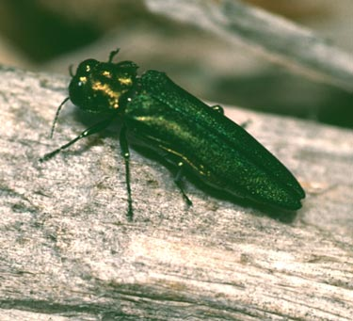
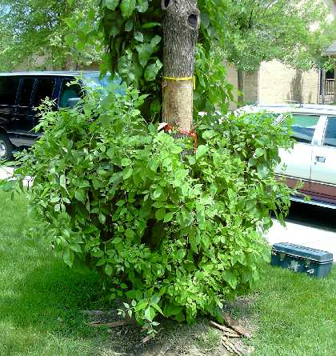
Landscape Management of EAB:
Non-target consequences on bees, good bugs, and birds
EAB life cycle
Native to Asia.
1-to 2 year.
Larvae feed under bark.
Adults emerge in May.
Asian ash defended with chemicals absent in NA ash.
Landscape management is removal or insecticides.

Slide 35
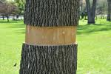
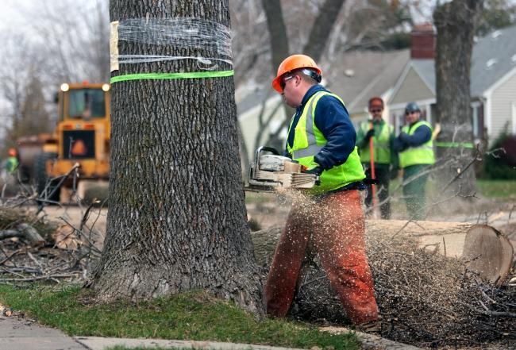
Landscape Management of EAB:
Non-target consequences on bees, good bugs, and birds
Economic and environmental risk from EAB
MN has the second largest population of ash trees in the US.
Since 2002, EAB killed over 50 million ash trees.
Estimated Ohio will spend as much as 1.3 billion dollars.

Slide 36
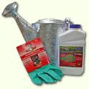
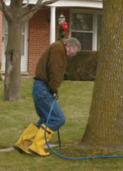
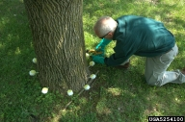
Landscape Management of EAB:
Non-target consequences on bees, good bugs, and birds
Three application methods
Passive soil drench
Soil injection
Trunk injection

Slide 37
Landscape Management of EAB:
Non-target consequences on bees, good bugs, and birds
Economic risk and high insecticide use from EAB
St Paul and Minneapolis Park and Rec. Board (MPRB) issue permits for trunk injection on public property.
Minneapolis passed a resolution asking homeowners to replace trees rather than treat on private property.
Long term use of insecticides carries environmental risk.
St. Paul before
St. Paul after

Slide 38
Landscape Management of EAB:
Non-target consequences on bees, good bugs, and birds
Economic risk and high insecticide use from EAB
Insecticide use will continue for many years until effectiveness of biocontrol is determined
Milwaukee, WI treated 33,000 trees with 1,300 liters ($475/liter). Estimates are 1.6 million for insecticide and personnel to treat the trees.

Slide 39
Landscape Management of EAB:
Non-target consequences on bees, good bugs, and birds
Environmental risk
Movement away from tree of insecticide in water to surface or ground water.
Uptake of insecticides from ash by other plants.
Non-target effects on nectar/ pollen feeding birds and insects.
Non-target effects on woodpeckers feeding on ash.

Slide 40
Landscape Management of EAB:
Non-target consequences on bees, good bugs, and birds
Imidacloprid and dinotefuran used for EAB management are water soluble and can leach. NY declared imidacloprid a reduced risk insecticide on LI due to well contamination.
CA initiated a review of imidacloprid's potential to move offsite and to harm non-targets.
Both the EPA and MDA are interested in data that addresses these concerns.

Slide 41
Landscape Management of EAB:
Non-target consequences on bees, good bugs, and birds
Imidacloprid and emamectin benzoate are toxic to birds and bees.
Imidacloprid can be used on other trees, especially linden and maple, which are used by bees, sapsuckers, and hummingbirds.
Emamectin benzoate is a restricted use insecticide due to hazards to applicators. It was previously registered for salmon and for cole crop. The Proclaim label states it is highly toxic to bees.

Slide 42
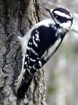
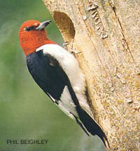
Landscape Management of EAB:
Non-target consequences on bees, good bugs, and birds
Non-target impacts of insecticide use on trunk feeders
In some trees, woodpeckers have removed up to 95% of EAB larvae (Cappaert et al. 2005b).
Birds are exposed to emamectin benzoate and imidacloprid when foraging for EAB on ash trees.
downy woodpecker
red-headed
woodpecker

Slide 43
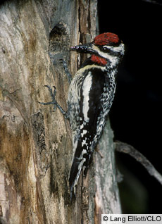
Landscape Management of EAB:
Non-target consequences on bees, good bugs, and birds
Its habit of making shallow holes in trees to get sap is exploited by other bird species, and the sapsucker can be considered a "keystone" species, one whose existence is vital for the maintenance of a community (Cornell Ornithology Lab).
yellow-bellied sapsucker

Slide 44
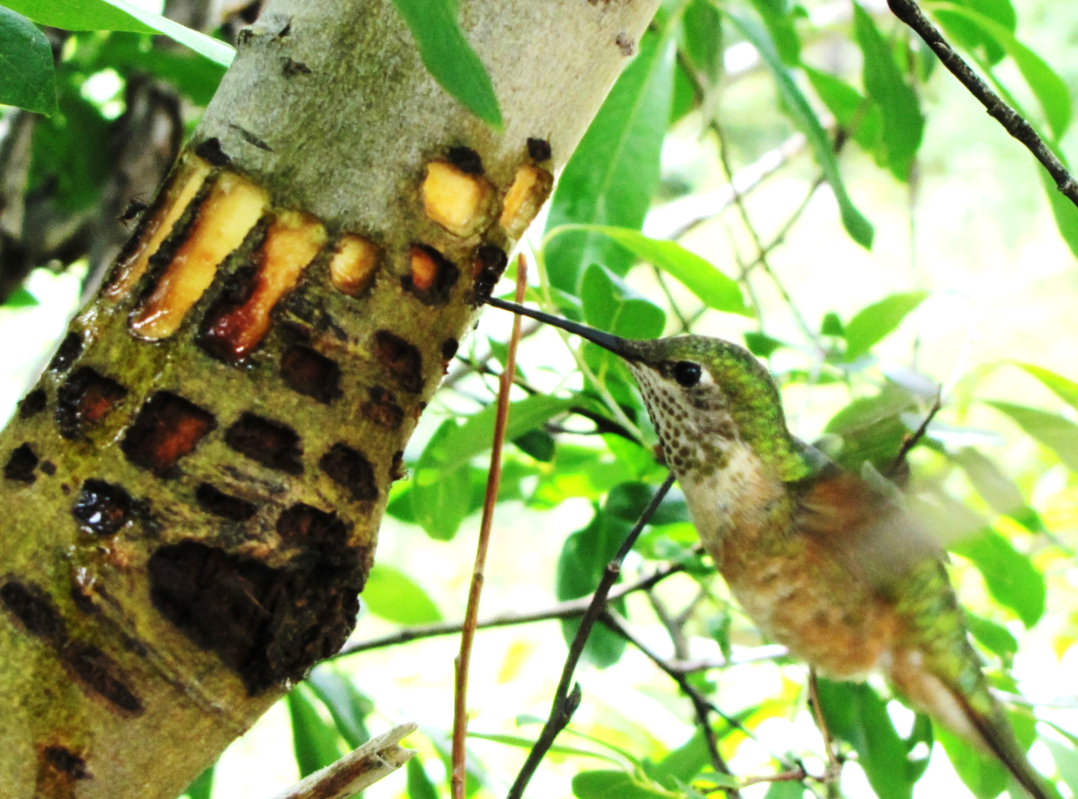
Landscape Management of EAB:
Non-target consequences on bees, good bugs, and birds
Non-target impacts of insecticide use on trunk feeders
Hummingbirds are attracted to sapsucker holes (MN DNR 1997 and Smitley et al. 2007).
Colorado broad-tailed hummingbird © Bob Bowers birdingthebrookeandbeyond.com/2012/09/14/the-sapsucker-a-hummingbirds-best-friend

Slide 45
Information about insecticides

Slide 46
1. Properties: Pyrethroids
Contact insecticides that destabilize nerve cell membranes. Chemistry based on botanical extracts of pyrethrum.
Do not last long on plants.
Toxic to fish and cats.
Toxic to bees.
Low mammalian toxicity.
Active ingredients
Bifenthrin (Talstar)
Cyfluthrin (Decathalon)
Deltamethrin (Deltagard)
Fluvalinate (Mavrik)
Lambda-cyhalothrin (Scimitar, Battle)
Permethrin (Astro, Spectracide)

Slide 47
1. Pyrethroid toxicity to humans
Insecticide (Common Name) bifenthrin |  | Trade Name(s) Talstar
Classification pyrethroid | LD₅₀ Oral (mg/kg) 375 | LD₅₀ Dermal (mg/kg) >2000
Manufacturer FMC

Slide 48
2. Properties: Neonicotinoids
Work on central nervous system, cause over-stimulation and blockage of the postsynaptic nicotine acetylcholine receptors.
Long duration of environmental persistence.
Highly toxic to bees.
Low mammalian toxicity.
Active ingredients
Imidacloprid
Clothianidin
Thiamethoxam
Dinotefuran

Slide 49
2. Neonicotinoid toxicity to humans
Insecticide (Common Name) imidacloprid |  | Trade Name(s) Merit, Marathon, Provado, Admire
Classification neonicotinoid | LD₅₀ Oral (mg/kg) 460 | LD₅₀ Dermal (mg/kg) 2000
Manufacturer Bayer

Slide 50
3. Properties: Organophosphates
Inhibit the enzyme cholinesterase. This prevents the termination of nerve impulse transmission.
Long lasting.
Toxic to bees.
Long term effects on humans so most of these insecticides are taken off the market.
Active ingredients
Acephate (Orthene) and malathion for homeowner use.
Chloropyrifos (golf courses and nursery only).
Dimethoate not very available, previously used for birch leaf miner sawfly

Slide 51
3. Organophosphate toxicity to humans
Insecticide (Common Name) acephate |  | Trade Name(s) Orthene
Classification organophosphate | LD₅₀ Oral (mg/kg) 235 | LD₅₀ Dermal (mg/kg) 400
Manufacturer Valent

Slide 52
3. Organophosphate toxicity to humans
Insecticide (Common Name) dimethoate |  | Trade Name(s) Cygon
Classification organophosphate | LD₅₀ Oral (mg/kg) 235 | LD₅₀ Dermal (mg/kg) 400
Manufacturer UAP

Slide 53
4. Properties: Carbamates
Inhibit the enzyme cholinesterase. This prevents the termination of nerve impulse transmission.
Short acting.
Toxic to bees.
Low mammalian toxicity.
Active ingredients
Carbaryl

Slide 54
4. Carbamate toxicity to humans
Insecticide (Common Name) carbaryl |  | Trade Name(s) Sevin
Classification carbamate | LD₅₀ Oral (mg/kg) 246 | LD₅₀ Dermal (mg/kg) >4000
Manufacturer Drexel

Slide 55
5. Unique class toxicity to humans
Insecticide (Common Name) chlorantranipirole |  | Trade Name(s) Acelepryn
Classification anthranilic diamide | LD₅₀ Oral (mg/kg) >5000 | LD₅₀ Dermal (mg/kg) >5000
Manufacturer Dow

Slide 56
5. Unique class toxicity to humans
Insecticide (Common Name) pymetrozine |  | Trade Name(s) Endeavor
Classification pyridine Inhibits sucking mouthparts | LD₅₀ Oral (mg/kg) >5000 | LD₅₀ Dermal (mg/kg) >2000
Manufacturer Syngenta

Slide 57
6. Microbial insecticides
Products of natural microbes.
Specific in action.
Active ingredients
Abamectin (Avid, by Syngenta): Toxic to bees
Spinosad (Conserve, by Dow): Low bee toxicity
Bacillus thuringiensis var. kurstaki
Bacillus thuringiensis var. tenebrionis
Bacillus thuringiensis var. israelensis
All 3 B.t. varieties have low toxicity to bees

Slide 58
6. Microbial insecticide toxicity to humans
Insecticide (Common Name) spinosad |  | Trade Name(s) Conserve, Entrust
Classification microbial | LD₅₀ Oral (mg/kg) 3783 | LD₅₀ Dermal (mg/kg) >5000
Manufacturer Dow

Slide 59
8. Properties: Insect growth regulators
Kill immature insects as they develop, by either
disrupting the molting process, or by producing sterile adults. All but neem products can kill aquatic crustaceans. Do not apply near streams.
Active ingredients
Halofenozide (Mach 2 by Dow): Used on turf for moths and grubs
Tebufenozide (Confirm by Dow)
Cyromazine (Citation by Syngenta)
Diflubenzuron (Dimilin by Uniroyal)
Fenoxycarb (Precision by Syngenta)
Hexythiazox (Hexygon by Gowan)

Slide 60
7. Insect growth regulator toxicity to humans
Insecticide (Common Name) halofenozide |  | Trade Name(s) MACH2
Classification molting accelerator | LD₅₀ Oral (mg/kg) >2850 | LD₅₀ Dermal (mg/kg) >2000
Manufacturer Dow

Slide 61
8. Miticides compatible with beneficials
Long residual:
Hexythiazox (Hexygon by Gowan)
Bifenazate (Floramite by OHP)
Clofentazine (Ovation by Scotts)
Chlorfenapyr (Pylon by BASF)

Slide 62
8. Miticide toxicity to humans
Miticide (Common Name) hexythiazox |  | Trade Name(s) Hexygon
Classification carboxamide | LD₅₀ Oral (mg/kg) >5000 | LD₅₀ Dermal (mg/kg) >5000
Manufacturer Gowan

