Slide 1
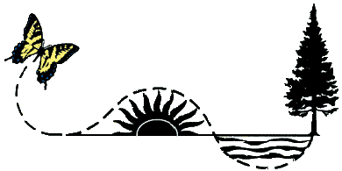
Bee Plants
Create a landscape that attracts pollinators
Emily Tenczar & Vera Krischik University of Minnesota
Please use the CUES Pollinator Conservation website www.entomology.umn.edu/cues/pollinators/
Look at the section on bees and pesticides for more information. Read the brochure “Pollinator Conservation” to understand the issues and how to mitigate pollinator decline.

Slide 2
Bee Plants
Why should you care?
Bees and other pollinators allow 70% of flowering plants to reproduce.
More than 30% of our food comes from insect-pollinated plants.
Other animals also rely on fruit and seeds from these plants.
Pollinators are at risk due to habitat loss, pesticide use, and diseases.
Providing plants that produce pollen and nectar is one way to help these beneficial insects.

Slide 3
Bee Plants
Plant selection
Bees need to consume pollen and nectar in order to complete their life cycles.
A variety of plants blooming from April to September offers a consistent food supply.
Trees, shrubs, flowers, and ground covers can provide forage for bees.
Perennials and woody plants, especially native species, can produce flowers for years.
For best results, select plants hardy to your zone and to your soil and light conditions. A local nursery can assist in selection.

Slide 4
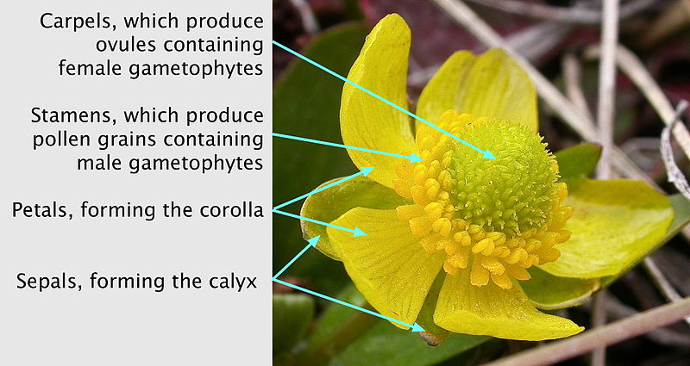
Bee Plants
Flower physiology
“Complete” or “perfect” flowers contain both male and female parts (like this Ranunculus).
Photo:
Ranunculus_glaberrimus_(5384213151).jpg: Matt Lavin
Derivative work: Peter coxhead [CC-BY-SA-2.0 (http://creativecommons.org/licenses/by-sa/2.0)], via Wikimedia Commons

Slide 5
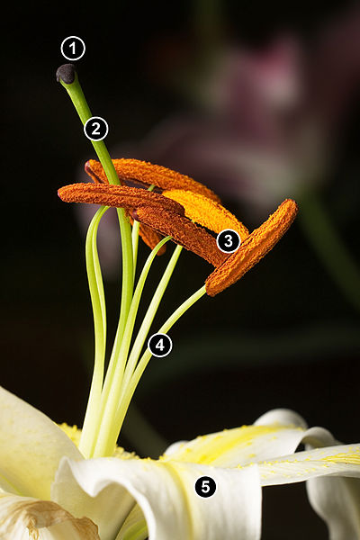
Bee Plants
Flower physiology
Christmas Lillium
Stigma: part of carpel (female)
Style: part of carpel (female)
Anthers: part of stamen (male)
Filament: part of stamen (male)
Sepal
Photo: JJ Harrison (jjharrison89@facebook.com) (Own work) [CC-BY-SA-3.0 (http://creativecommons.org/licenses/by-sa/3.0)], via Wikimedia Commons

Slide 6
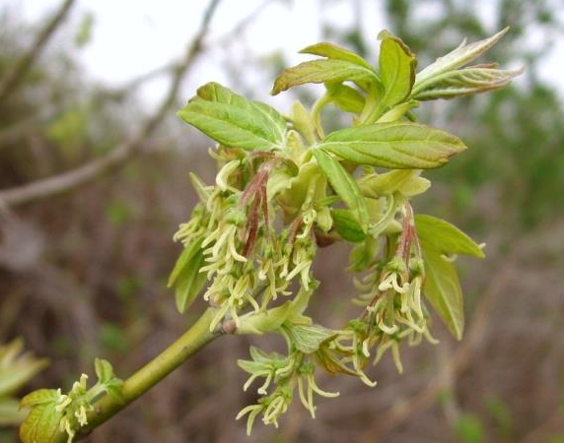
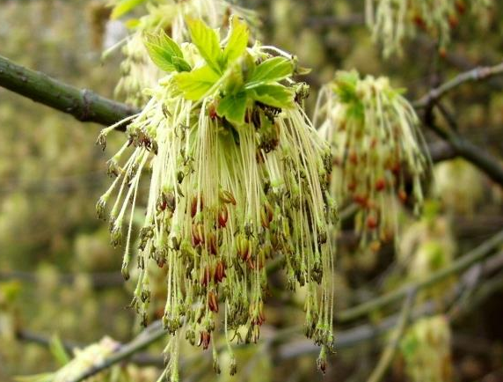
Bee Plants
Flower physiology
Monoecious plants have functional male and female parts on different flowers within the same plant (most maples, birch, pumpkin).
Dioecious plants have functional male and female parts on different plants (boxelder, holly, walnut).
Pictured: boxelder (Acer negundo) Female (top) and male
Photos: Jan Samanek, State Phytosanitary Administration, Bugwood.org

Slide 7
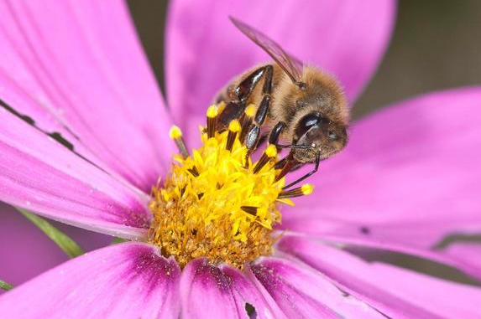
Bee Plants
How are plants pollinated?
Self (Viola spp.)
By wind (corn, maples to some extent, etc.)
By animals, mainly insects (most plants)
Photo: Joseph Berger, Bugwood.org

Slide 8
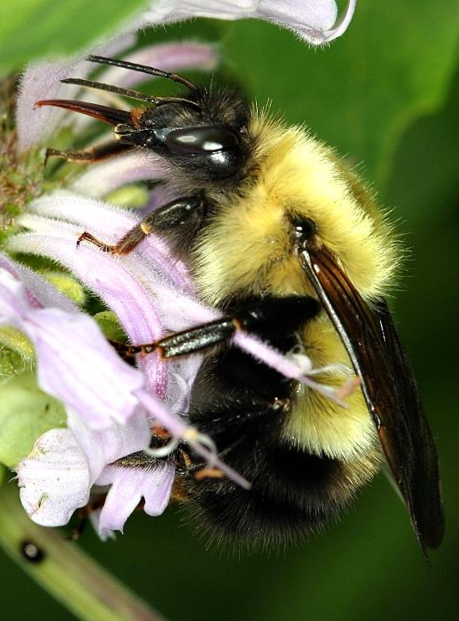
Bee Plants
proboscis
How are plants pollinated?
Bees and many other insects coevolved to feed on flower nectar.
Plants use nectar to lure pollinators.
Many pollinators have a proboscis that fits into the flower to drink the nectar.
Photo: David Cappaert, Michigan State University, Bugwood.org

Slide 9
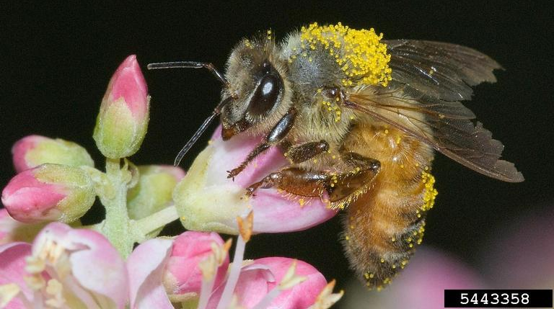
Bee Plants
How are plants pollinated?
Pollen collects on hairs and scales of insects.
Most bees also have specialized structures called corbiculae or scopae to collect pollen.
corbicula
Photo: Susan Ellis, Bugwood.org

Slide 10
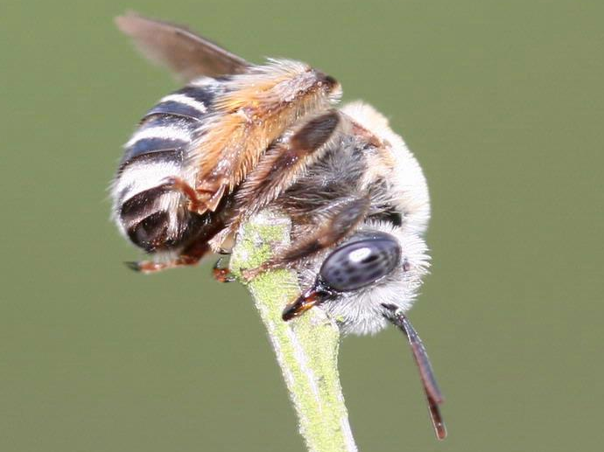
Bee Plants
1. corbicula with pollen
2. scopae on abdomen
3. scopae on hind leg
4. scopae on hind leg
Photos:
1. Dennis Riggs, Denrig, Inc., Bugwood.org
2. Whitney Cranshaw, Colorado State University, Bugwood.org
3. Beatriz Moisset (Own work) [GFDL (http://www.gnu.org/copyleft/fdl.html) or CC-BY-SA-3.0-2.5-2.0-1.0 (http://creativecommons.org/licenses/by-sa/3.0)], via Wikimedia Commons
4. Johnny N. Dell, Bugwood.org

Slide 11
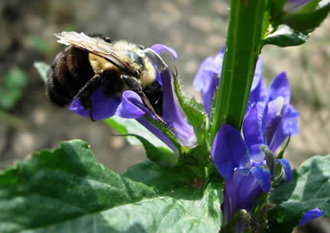
Bee Plants
How are plants pollinated?
Some flowers, such as Lobelia (left) and Penstemon (right) are shaped so that pollen collects on the insect during feeding.
Pollen is transferred when the insect moves from flower to flower.
Photos:
Left: Prairie Moon Nursery, www.prairiemoon.com
Right: Terry Spivey, USDA Forest Service, Bugwood.org

Slide 12
Bee Plants
Additional tips for plant selection
Native or heirloom varieties are favorable.
Avoid “double flower” varieties of bedding plants; these do not have enough pollen and nectar to support pollinators.
Avoid dead-heading plants after blooming because some flowers (such as composites) actually contain many tiny pollen and nectar parts even after petals drop.
Be sure that purchased plants have not been treated with neonicotinoids; these chemicals move into nectar and harm pollinators.

Slide 13
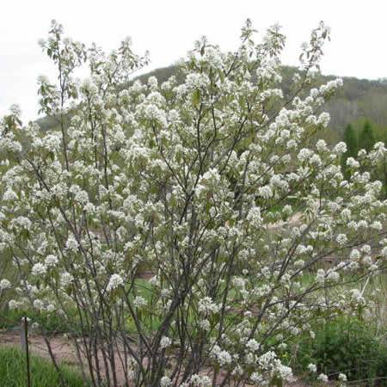
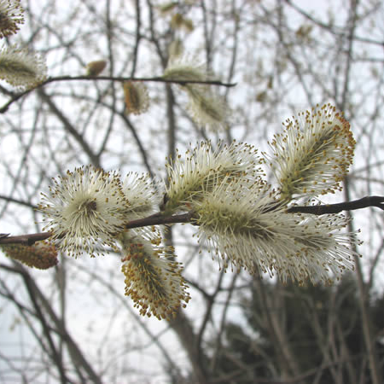
Early Season Bloomers
Bee Plants
NATIVE!
NATIVE!
Serviceberry (Amelanchier spp.)
Pussy willow (Salix discolor)
Photos: Prairie Moon Nursery, www.prairiemoon.com

Slide 14
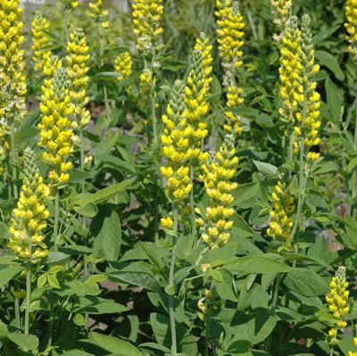
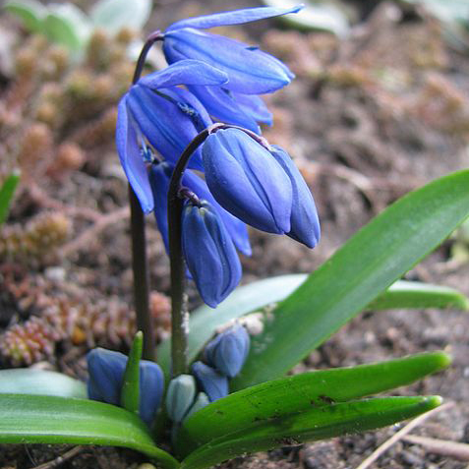
Early Season Bloomers
Bee Plants
Eastern US Native
Carolina lupine (Thermopsis villosa)
Siberian squill (Scilla siberica)
Photos: Carolina lupine: Prairie Moon Nursery, www.prairiemoon.com
Siberian squill: Heike Löchel (fotografiert von Heike Löchel) [CC-BY-SA-2.0-de (http://creativecommons.org/licenses/by-sa/2.0/de/deed.en)], via Wikimedia Commons

Slide 15
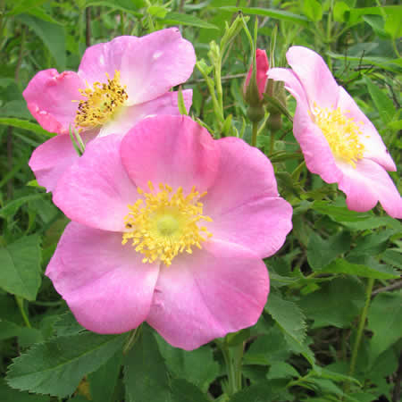
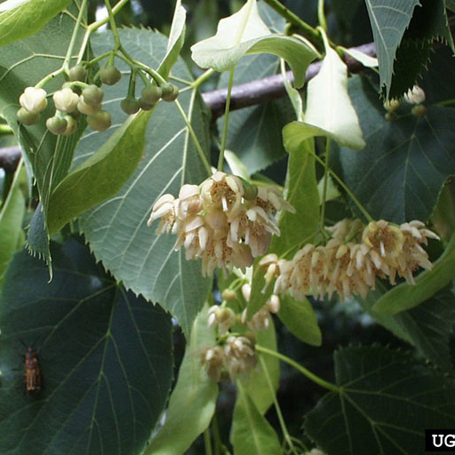
Early to Mid Season Bloomers
Bee Plants
NATIVE!
NATIVE!
Wild rose (Rosa species)
Basswood, linden (Tilia americana)
Photos: Wild rose: Prairie Moon Nursery, www.prairiemoon.com
Basswood: Paul Wray, Iowa State University, Bugwood.org

Slide 16
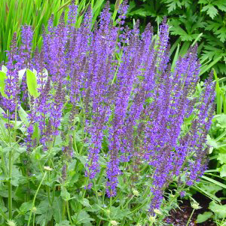
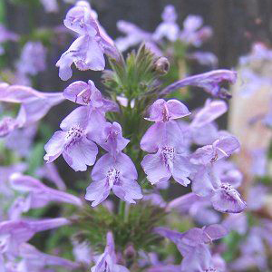
Early to Mid-Season Bloomers
Bee Plants
Garden sage (Salvia nemorosa 'May Night')
Catmint (Nepeta x faassenii)
Photos: North Creek Nurseries, www.northcreeknurseries.com

Slide 17
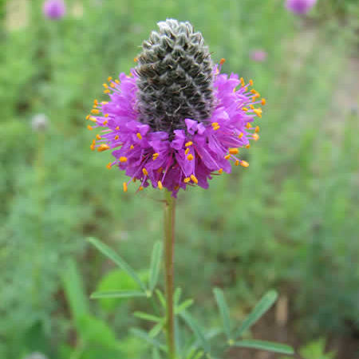
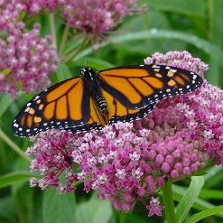
Mid Season Bloomers
Bee Plants
*
NATIVE!
NATIVE!
Purple prairie clover (Petalostemum candida)
Swamp milkweed (Asclepias incarnata)
Photos: Purple prairie clover: Prairie Moon Nursery, www.prairiemoon.com
Swamp milkweed: North Creek Nurseries, www.northcreeknurseries.com
*Also consider: Common milkweed (A. syriaca), butterfly weed (A. tuberosa)

Slide 18
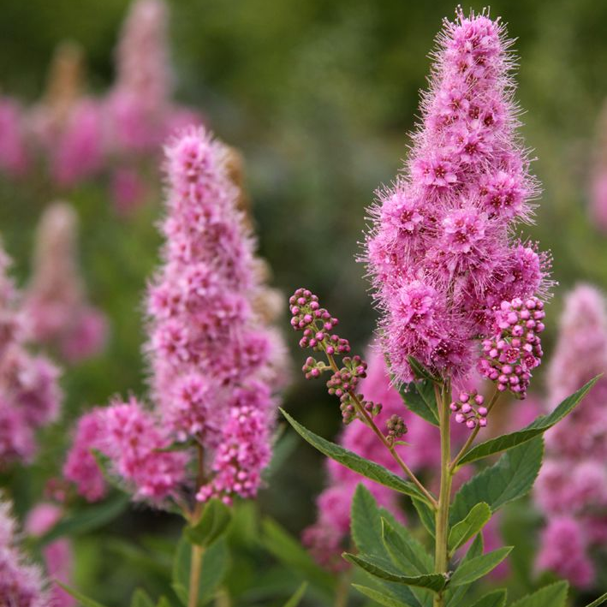
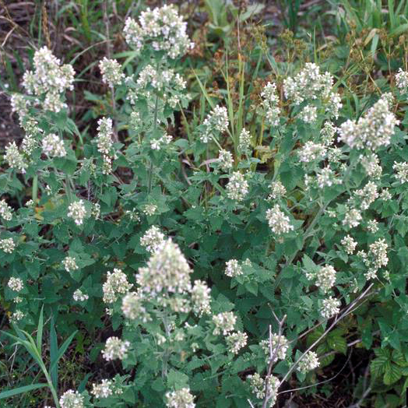
Mid Season Bloomers
Bee Plants
Billard's spiraea
(Spiraea x billardii 'Triumphans')
Catnip (Nepeta cataria)
Photos:
Billard’s Spiraea: Alfred Osterloh, via Hortipedia Commons
Catnip: Theodore Webster, USDA Ag Research Service, Bugwood.org

Slide 19
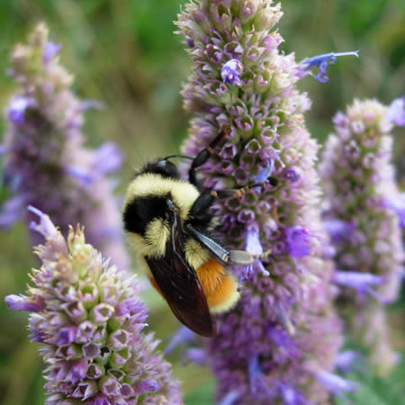
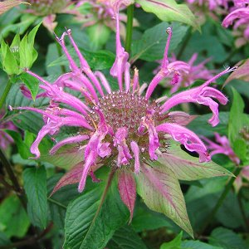
Mid to Late Season Bloomers
Bee Plants
NATIVE!
NATIVE!
Anise hyssop (Agastache foeniculum)
Wild bergamot
(Monarda fistulosa)
Photos: Anise hyssop: Prairie Moon Nursery, www.prairiemoon.com
Wild bergamot: North Creek Nurseries, www.northcreeknurseries.com

Slide 20
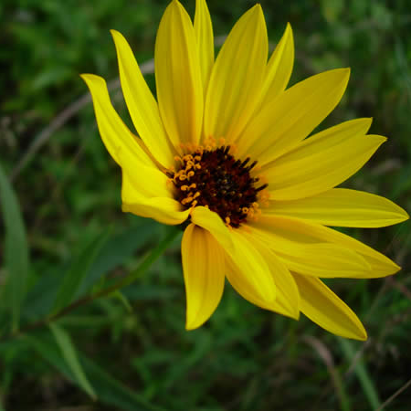
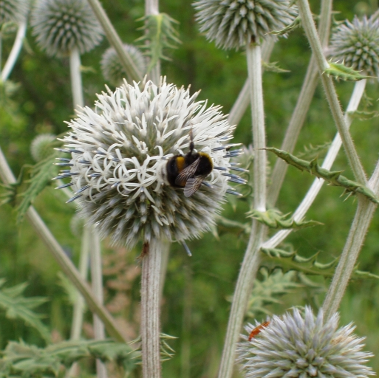
Mid to Late Season Bloomers
Bee Plants
NATIVE!
Sunflower (Helianthus species)
Globethistle (Echinops species)
Photos: Sunflower: Prairie Moon Nursery, www.prairiemoon.com
Globethistle: Barbara Tokarska-Guzik, University of Silesia, Bugwood.org

Slide 21
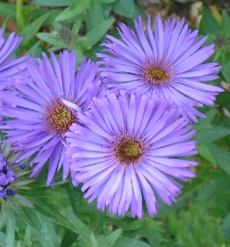
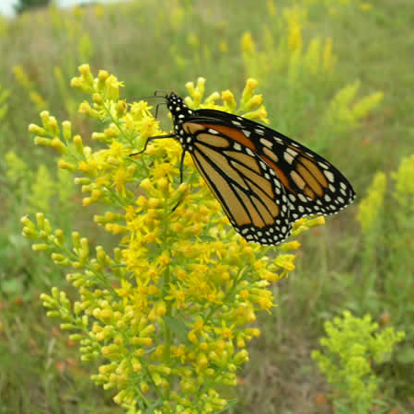
Late Season Bloomers
Bee Plants
NATIVE!
NATIVE!
New England aster (Symphyotrichum novae-angliae)
Goldenrod (Solidago species)
Photos: New England aster: North Creek Nurseries, www.northcreeknurseries.com
Goldenrod: Prairie Moon Nursery, www.prairiemoon.com

Slide 22
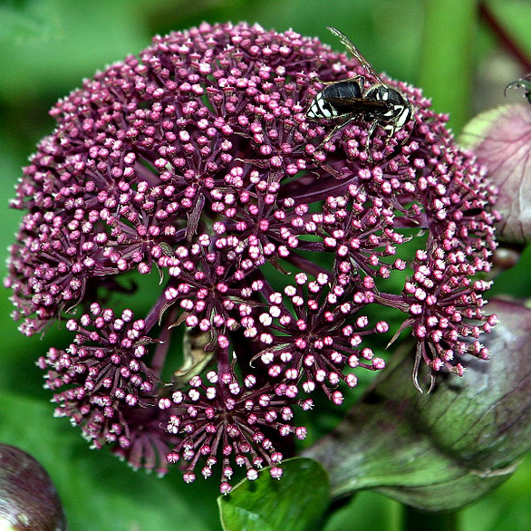
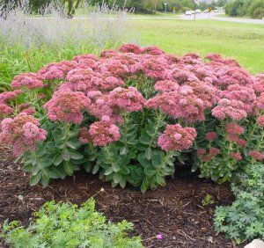
Late Season Bloomers
Bee Plants
Korean angelica (Angelia gigas)
Stonecrop (Sedum species)
Photos: Korean angelica: Hardyplants at English Wikipedia (Own work) [Public domain], via Wikimedia Commons
Stonecrop: North Creek Nurseries, www.northcreeknurseries.com

Slide 23
Bee Plants Minnesota Nurseries with Native Plants (from Xerces Society)
Xerces Pollinator Conservation Seed Store: pre-mixed blends of pollen and nectar plants. www.xerces.org/pollinator-seed
Feder Prairie Seed (Blue Earth): south central MN prairie forbs and grass seeds. www.federprairieseed.com
Landscape Alternatives, Inc. (Shafer): prairie flowers, grasses, and woodland flowering plants. www.landscapealternatives.com
Minnesota Native Landscapes (Otsego): seed mixes, trees and shrubs. www.mnnativelandscapes.com
Morning Sky Greenery (Morris): MN and Upper Midwest plants. www.morningskygreenery.com
Natural Shore Technologies, Inc. (Maple Plain): moisture-loving prairie plants and MN shore and wetland stock. www.naturalshore.com
Out Back Nursery, Inc. (Hastings): MN woodland, floodplain, savanna, wetland, shoreline, and prairie species. www.outbacknursery.com
Prairie Moon Nursery (Winona): Upper Midwest prairie, savanna, woodland, and wetland seeds and plants. www.prairiemoon.com
Prairie Restorations, Inc. (Princeton): MN prairie, savanna, wetland, woodland, and shoreline seeds and plants. www.prairieresto.com
Shooting Star Native Seeds (Spring Grove): Upper Midwest prairie and wetland seed and seed mixes. www.shootingstarnativeseed.com
Spring Lake Restoration Nurseries (Prior Lake): east-central MN and northwest WI plants and seeds. www.restorationnurseries.com
For a complete list visit www.entomology.umn.edu/cues/pollinators/plants.html or www.xerces.org/pollinators-great-lakes-region

Slide 24
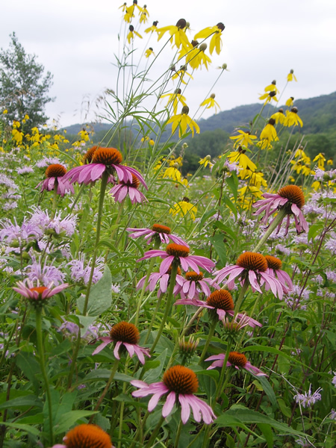
THE END
CUES Pollinator Conservation Page: www.entomology.umn.edu/cues/pollinators
Prairie Moon Nursery: www.prairiemoon.com
University of Minnesota Bee Lab: www.beelab.umn.edu
University of Minnesota Department of Entomology: www.entomology.umn.edu
University of Minnesota Extension Service: www.extension.umn.edu
The Xerces Society for Invertebrate Conservation: www.xerces.org
Photo: Prairie Moon Nursery, www.prairiemoon.com

